Slide 1
Training Presentation
Presented by, Rose Mary Thomas

Slide 2
Contents
Javascript Typescript and Bootstrap
Mongodb
Vue js
Asp.net core
Revv domain

Slide 3
Revv

Slide 4







JavaScript
Structure of the webpage (headings, paragraphs, links, etc.)
HTML
Styling the HTML (colors, layout, fonts)
CSS
Interactivity and dynamic behavior
Scripting language of the web
Runs on the browser (client-side)
Handles logic, interactivity, DOM, API calls
JavaScript
JavaScript Functions & Scope
Objects & Arrays
ES6+ Features
Destructuring
Spread/rest operators
Modules (import/export)
let, const
Arrow functions
Template literals

Slide 5
Functions in javascript
Function Declaration
Function Expression
Arrow Functions
Declares a function with a name.
Can be called before it's defined (hoisting applies).
function add(a, b) { return a + b;}console.log(add(2, 3)); // Output: 5
Defines a function and assigns it to a variable.
Not hoisted, so it must be defined before use.
const multiply = function(a, b) { return a * b;};console.log(multiply(4, 5)); // Output: 20
Introduced in ES6.
Shorter syntax, especially useful for one-liners.
Does not bind its own this, arguments, or super.
const divide = (a, b) => a / b;console.log(divide(10, 2)); // Output: 5

Slide 6
Scope in javascript
Block scope
Function scope
Global scope
let and const create block-scoped variables
Accessible only within the block where they are defined
Helps prevent accidental access outside the block
if (true) {
let blockLet = "Block scoped with let";
const blockConst = "Block scoped with const";
console.log(blockLet); // Accessible
console.log(blockConst); // Accessible
}
// console.log(blockLet); // Error
// console.log(blockConst); // Error
Variables declared inside a function are only accessible within that function
Same variable names can be reused in different functions without conflict
function funcScope() {
if (true) {
var funcScopedVar = "I am function-scoped";
}
console.log(funcScopedVar); // Accessible
}
funcScope();
Declared outside functions or blocks
Accessible throughout the entire code
Overuse can cause naming conflicts and maintenance issues
var globalVar = "I am global";
function showGlobal() {
console.log(globalVar); // Accessible
}
console.log(globalVar); // Also accessible

Slide 7
Objects & Arrays
Objects store data as key-value pairs
Keys are strings (or symbols), and values can be any type
Used to represent real-world entities
Arrays store ordered collections of values
Values can be of any type (strings, numbers, objects, etc.)
Indexed starting from 0
Objects
Arrays
02
const person = {
name: "Alice",
age: 25,
greet: function() {
console.log("Hello!");
}
};
console.log(person.name); // Accessing a value
person.greet(); // Calling a method
const fruits = ["Apple", "Banana", "Cherry"];
console.log(fruits[0]); // "Apple"
fruits.push("Mango"); // Add item

Slide 8
ES6+ Features
Block Scope
Arrow Functions
for...of Loop
let and const provide block-level scoping.
let is mutable, const is for constants.
let x = 10;
const y = 20;
if (true) {
let z = 30;
console.log(z); // 30
}
Short syntax for function expressions.
Lexically binds this.
const add = (a, b) => a + b;
console.log(add(2, 3)); // 5
Iterates over arrays, strings, maps, etc.
const arr = [10, 20, 30];
for (const num of arr) {
console.log(num);
}
Map
Set
Array.entries()
Stores key-value pairs.
Keys can be any data type.
const map = new Map();
map.set("name", "Alice");
console.log(map.get("name")); // Alice
Stores unique values only.
const set = new Set([1, 2, 2, 3]);
console.log(set); // Set(3) {1, 2, 3}
Returns key/value pairs of array.
const fruits = ["Banana", "Orange", "Apple"];
for (let [index, value] of fruits.entries()) {
console.log(index, value);
}

Slide 9
ES6+ Features
Array.from()
Array.keys()
Array.find()
Converts strings or iterable objects to arrays
let text = "ABCDEFG";
const myArr = Array.from(text);
console.log(myArr); // [ 'A', 'B', 'C', 'D', 'E', 'F', 'G' ]
.
Returns iterator of array keys (indexes).
const fruits = ["Banana", "Orange", "Apple"];
for (let key of fruits.keys()) {
console.log(key);
}
Returns first value that passes a test.
const numbers = [4, 9, 16, 25];
const first = numbers.find(n => n > 18);
console.log(first); // 25
Array.findIndex()
Array.every()
Array.some()
Checks if all elements match a condition.
const ages = [32, 33, 16];
console.log(ages.every(age => age > 18)); // false
Checks if any element matches a condition.
const ages = [3, 10, 18, 20];
console.log(ages.some(age => age > 18)); // true
Returns index of first match based on condition.
const numbers = [4, 9, 16, 25];
const index = numbers.findIndex(n => n > 18);
console.log(index); // 3

Slide 10

Typescript
01
Superset of JavaScript
Adds static typing
Helps catch errors early
02
Advanced TypeScript Features
03
TypeScript & JavaScript Interoperability
04
TypeScript compiles to JavaScript
Can use .js libraries inside .ts code
Helps teams gradually migrate
05
Object-Oriented TypeScript

Slide 11
Advanced TypeScript Features
Union
Intersection
Mapped
A union type allows a value to be one of several types. It's useful when a variable could hold different types of values.
function printId(id: number | string) {
console.log("ID: " + id);
}
printId(101);
printId("A102");
An intersection type combines multiple types into one. It represents a type that satisfies all the combined types.
type Admin = {
name: string;
privileges: string[];
};
type Employee = {
name: string;
startDate: Date;
};
type AdminEmployee = Admin & Employee;
const user: AdminEmployee = {
name: "Rose",
privileges: ["edit", "delete"],
startDate: new Date()
};
Create new types by transforming properties of existing types
Common for making properties readonly, optional, etc.
type Readonly<T> = {
readonly [K in keyof T]: T[K];
};
interface User {
name: string;
age: number;
}
const readonlyUser: Readonly<User> = { name: "John", age: 30 };
// readonlyUser.age = 31; ❌ Error: Cannot assign to 'age'

Slide 12
Advanced TypeScript Features
Conditional
Literal
Advanced Generics
Restrict variables to specific allowed string or number values
let direction: "up" | "down" | "left" | "right";
direction = "up"; // ✅
direction = "back"; // ❌ Error
Generic Functions
Create flexible, reusable type-safe functions
Generic Constraints
Restrict generic types to those meeting specific conditions
Apply types based on conditions (type logic)
Works like ternary operator at the type level
type IsString<T> = T extends string ? "Yes" : "No";
type Test1 = IsString<string>; // "Yes"
type Test2 = IsString<number>; // "No"

Slide 13
Object-Oriented TypeScript (OOP)
Feature
Description
Example
Blueprint for creating objects.
class MyClass {
...}
Class
Interface
Defines a contract for objects.
interface
MyInterface {...}
Enables a class to inherit from another class.
class Child extends
Parent {...}
Inheritance
Restricts visibility of class members.
public,
private,
protected
Access Modifiers

Slide 14
Object-Oriented TypeScript (OOP)
Description
Example
Feature
Base class for other classes. Can't be instantiated.
abstract class
Abstract Classes
Belong to the class, not instances.
static
myMethod()
Static Members
Encapsulation
Restricts access to class properties.
Use private
Polymorphism
Allows different behaviors through a common interface.
Overriding
methods

Slide 15
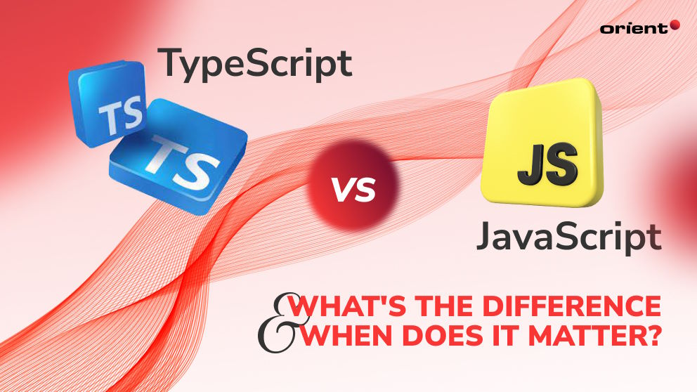

Slide 16

Bootstrap
01
Popular CSS framework
Helps build responsive websites
02
Pre-built components and utility classes
Responsive grid system
03
UI components: Navbars, Cards, Buttons, Alerts
Utility classes: Margin, Padding, Display, etc.
04
Limitations of Bootstrap
Overuse leads to similar-looking websites
05
May override custom designs
Requires some learning for grid/layout system

Slide 17
Mongodb
Querying in MongoDB
Common Operations:
Filtering: { field: value }, $gt, $lt, $in, $and, $or
Projection: Select specific fields to return
Sorting: .sort({ field: 1/-1 })

Slide 18
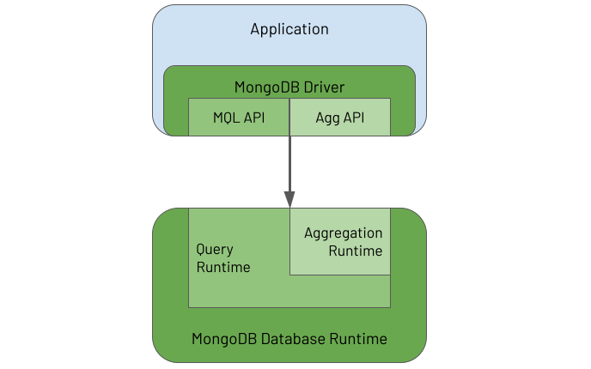
Mongodb

Slide 19
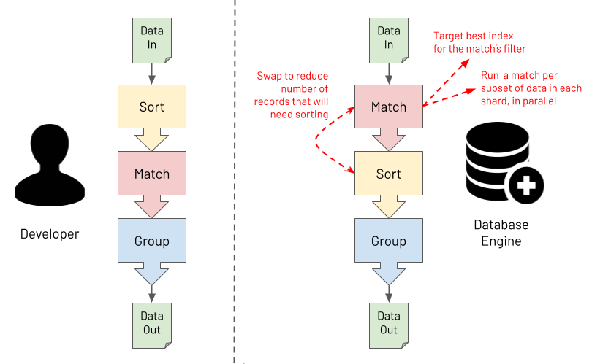

Slide 20
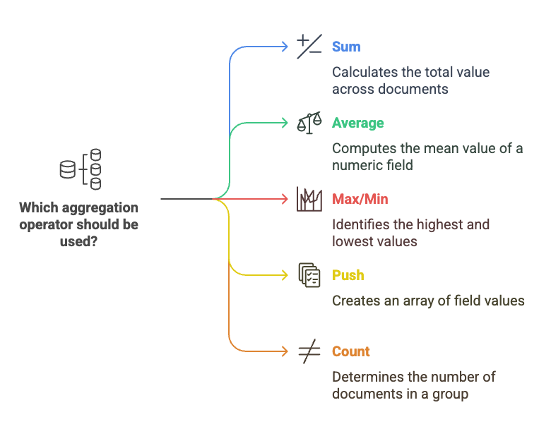

Slide 21
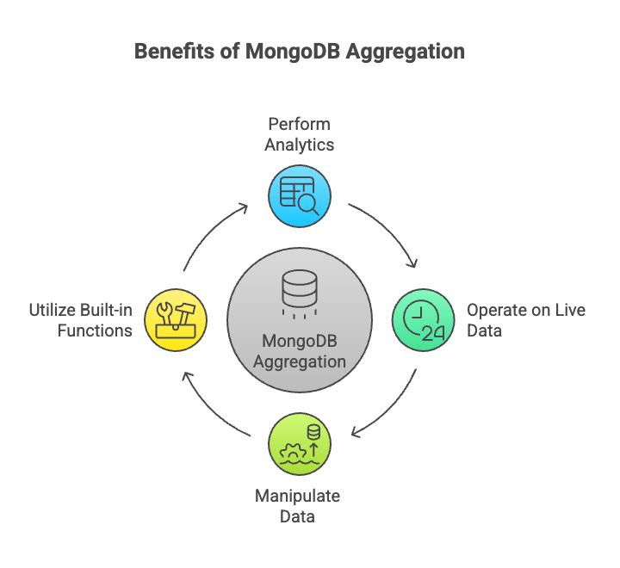

Slide 22
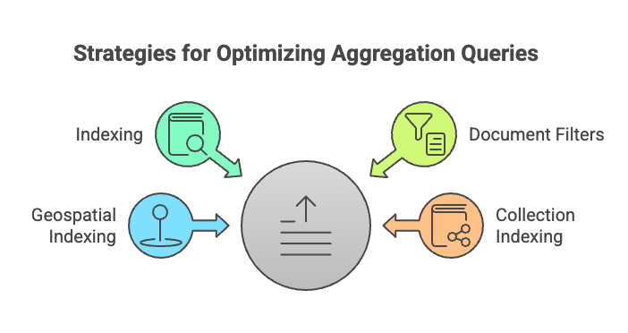

Slide 23
Security:
Authentication – users, roles
Authorization – role-based access
Network – firewall, TLS
Sharding
Horizontal scaling for big data
Data distributed across shardsRequires shard key
01
04
Mongodb
Backup:
mongodump/mongorestore
Atlas Backup
File system snapshots
Performance Tuning
Slow Query Analysis – use explain()
Optimize Aggregations – limit data early
02
05
Replication
Replica Set = Primary + Secondaries
High availability and failover
Read from secondary (read preference)
Performance Tuning
Use Indexes Wisely
Avoid Unbounded $group, $lookup
Monitor with Atlas Profiler or mongostat
03
06

Slide 24
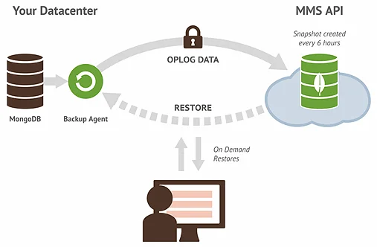
Restore and backup

Slide 25
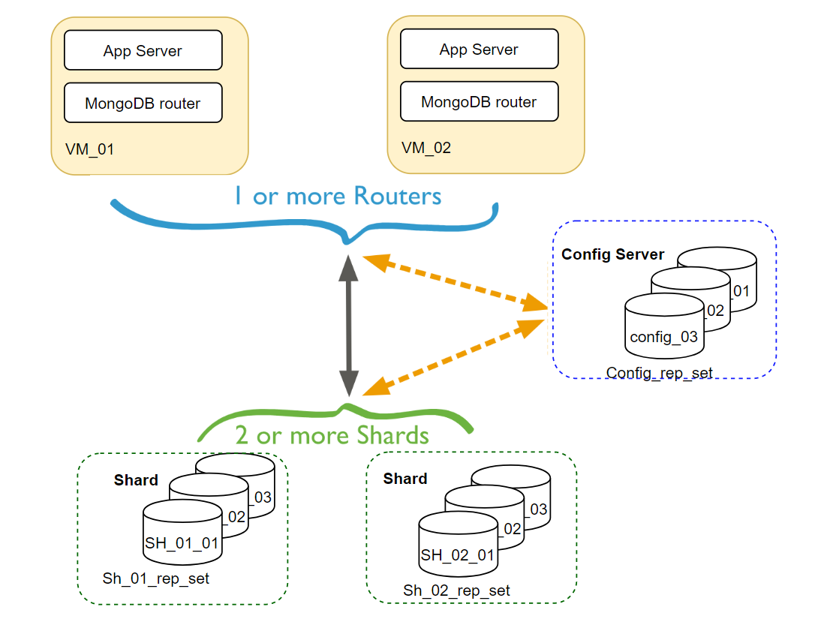
Sharding

Slide 26
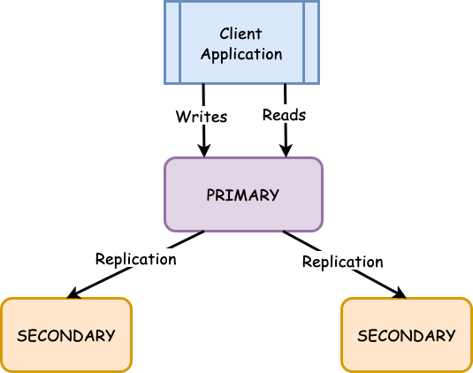
Replication

Slide 27
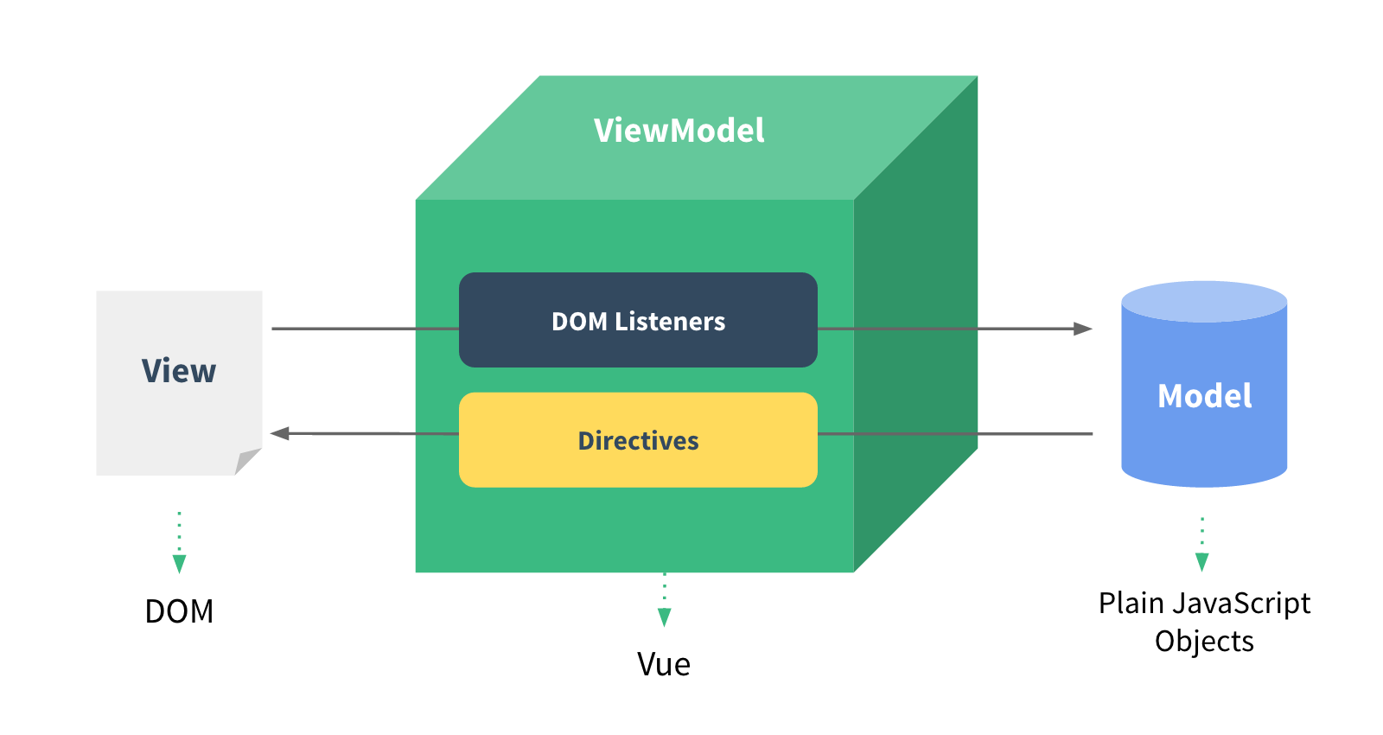
Vue js

Slide 28
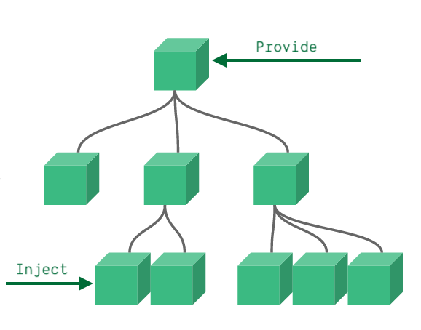
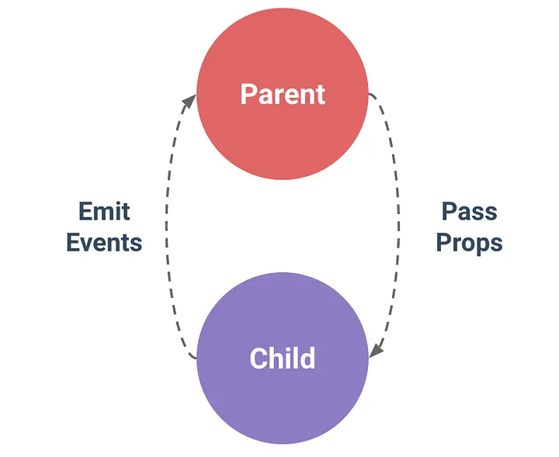
Provide and Inject
Emit and Props

Slide 29
Vue js
Default Slot
Named Slots
Scoped Slots
Watchers
Used to run custom code when data changes — best for API calls, side effects, or complex tasks.
watch: {
username(newVal, oldVal) {
console.log(`Username changed from ${oldVal} to ${newVal}`);
}
}

Slide 30
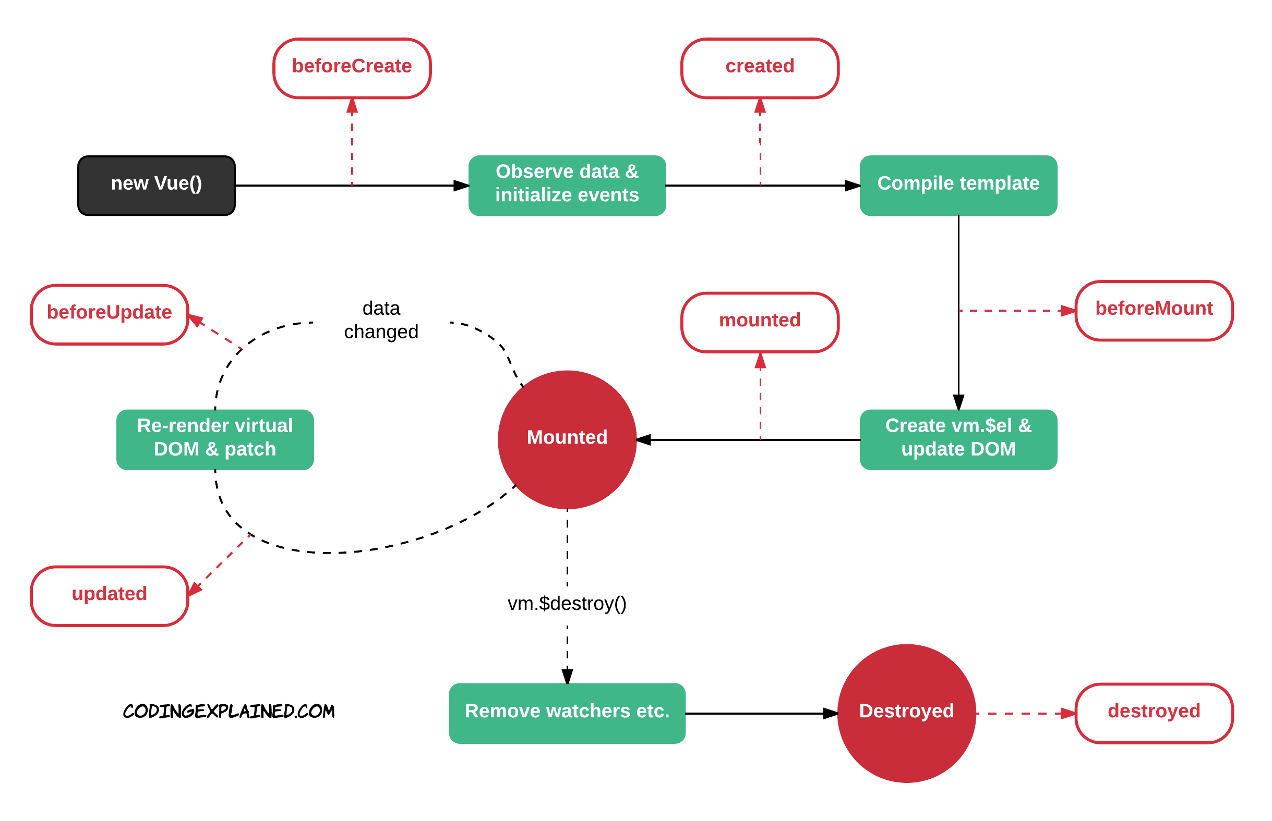
Lifecycle hooks

Slide 31
Vue js
(Form Validation)
Built-in or custom rules
VeeValidate is a form validation
library
Vue
Unit
Router
Validate
Testing
Vue Components
Official routing library
Map URLs to components
Navigate between views
Vee
Test individual components, methods, and logic

Slide 32
Asp.net core
Cross-platform, open-source runtime from Microsoft
Supports Web, Desktop, Cloud, Mobile, Microservices
Fast performance and modular
Dependency Injection in ASP.NET Core
DI is built-in to ASP.NET Core
Built-in IoC Container
Register lifetimes: AddSingleton, AddScoped, AddTransient
Minimal config needed
Supports custom containers like Autofac

Slide 33
Asp.net core
Working with Middleware
Middleware = request pipeline components
Custom Middleware
app.UseMiddleware<MyMiddleware>();
Serving Static Files
Serve from wwwroot:
app.UseStaticFiles();
Exception Handling in ASP.NET Core
Logging in .NET Core
Built-in logging providers: Console, Debug, EventLog, etc.

Slide 34
Loosely Coupled with MediatR (CQRS)
CQRS: Command-Query Responsibility Segregation
MediatR for in-process messaging:
Onion Architecture
Layers: Core, Application, Infrastructure, UI
Dependency Rule: Inner layers know nothing about outer ones

Slide 35
Revv domain

